Slide 1
Bomby
Word guessing game

Slide 2
Idea
The word guessing game.
The player:
Explain the word that is on the screen to others
Pass the bomb when somebody guesses it.
Game over when bomb makes explosive sound

Slide 3
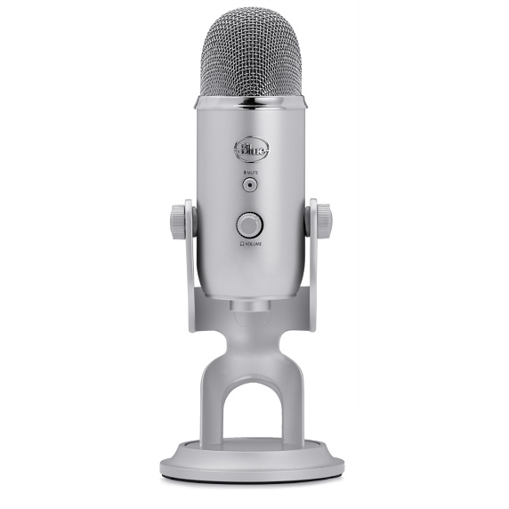
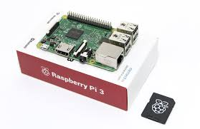
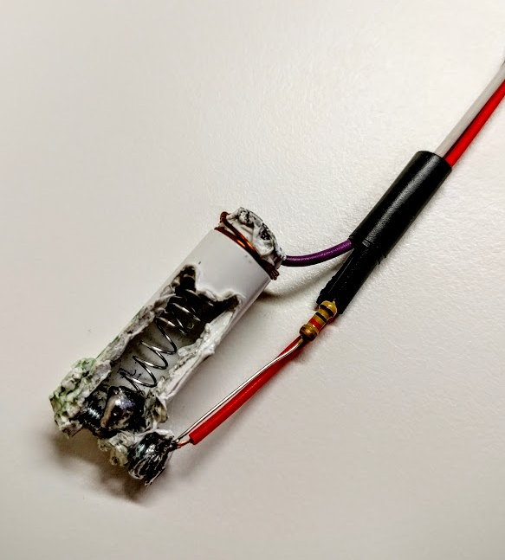
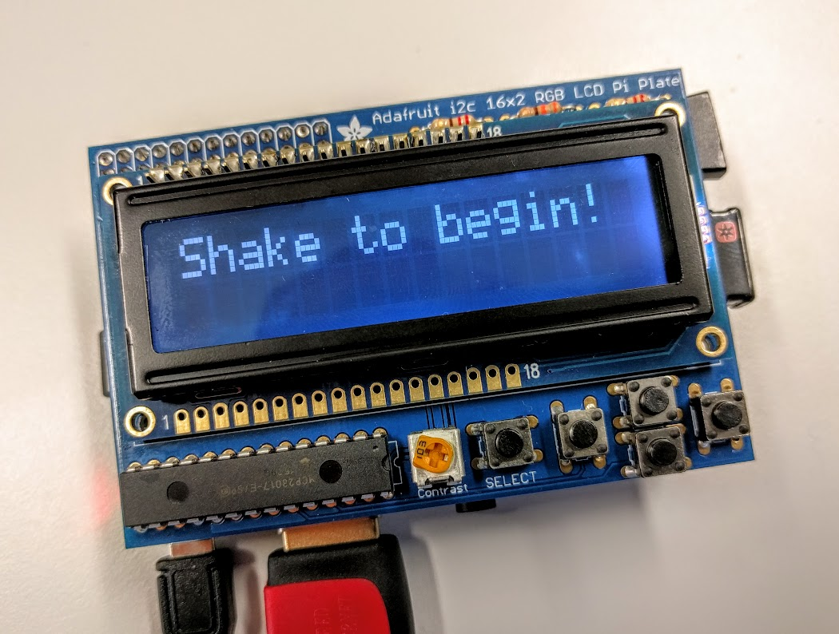
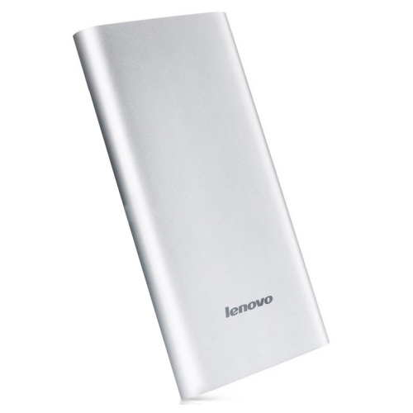
Components
Controller: Raspberry PI3 Sensors: Microphone, Shake sensor Display: LCD 16x2
Power: Battery Mechanical structure Software
Ideally - plastic cage Implementation in python

Slide 4
Software
4 main classes:
Display 1. Show greeting 2. Show next word 3. Show game over | Sound 1. Determine time 30-60s 2. Play ticking sound for determined time 3. Play exploding sound 4. Notify other threads game finished | Speech recognition 1. Record sound (cross recording) 2. Recognize track using google, wit.ai, and “sphinx” 3. Check for a match | Game engine 1. Initialization 2. Thread managing 3. Restart the game

Slide 5
Speech recognition
Cut word problem
2s
2s 2s
Word “Marmalade” and “Sugar”
would not be recognized
Solution:
Now all words are be kept. 4s
I think it is marm
alade. Or maybe s
ugar. What is wron
I think it should be marm
alade. Or maybe it’s sugar
I think it should be marmalade. Or maybe it’s sugar
Notes:
Here we can say that there are problems with recording the sound - it will eventually cut words that are in the middle

Slide 6
Result (video)
https://youtu.be/KEYknByKYtY

Slide 7
Better results would be possible?
Write your own speech recognizer
Find the one that can output the internal probabilities for every prediction.
Set threshold
Check all words that are with certain probability.
Network with less latency.
More accurate voice recognition
Our own token for google voice recognition API.

Slide 8
QA
Project repository: https://github.com/yesanton/bomby_robotics

